Slide 1
Coded Computation for Multicore Setups
The 2017 IEEE International Symposium on Information Theory (ISIT)

Slide 2
INTRODUCTION
DISTRIBUTED MODEL AND PROBLEM FORMULATION
UNCODED SCHEMES
CODED SCHEMES
SIMULATION RESULTS

Slide 3
1. INTRODUCTION
In recent years, deploying algorithms on distributed systems has become the de facto choice for large-scale machine learning and data analytics. However, the performance of these algorithms is critically affected by bottlenecks in communication and delays caused by stragglers, or nodes that are substantially slower than the average node in the same system.
Recently, the authors in [1] propose the use of erasure codes(MDS) to mitigate the effects of stragglers; the high level idea is that stragglers can be treated as erased nodes
These studies have limited their focus to distributed setups where the coding technique is oblivious to the potentially multicore nature of the each individual node.
In practice, several of the publicly available cloud infrastructures provide CPU instances that can have up to 128 cores (e.g., x1.32xlarge on amazon EC2), or GPU instances with 1000s of CUDA cores

Slide 4
1. INTRODUCTION
One could argue that each of these cores can be considered as an individual compute node in the distributed network
However, due to the fact that core-to-RAM communication is orders of magnitude faster than node-to-node communication in the network, we can aim for a more powerful solution that fully exploits the multicore processing architecture in modern distributed computing.
Accordingly, in this work, we focus on master-worker architectures, where each of the n workers has p equally computationally capable cores. Our goal is to compute a separable function
as fast as possible
Main contributions:
给出了关于job分配和coded computing的算法，使得运行时间最短
任何不用coding的运行时间与用coding的运行时间之间存在unbounded gap

Slide 5
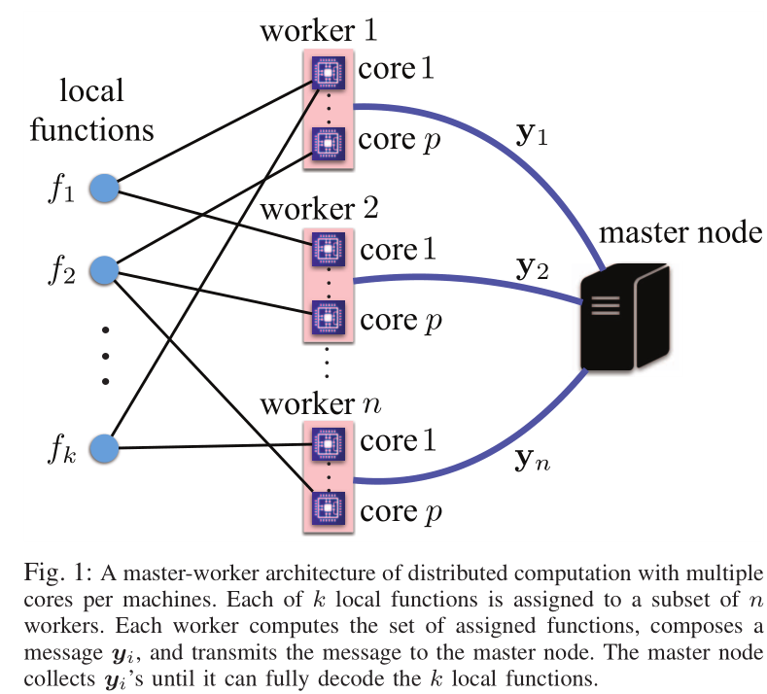

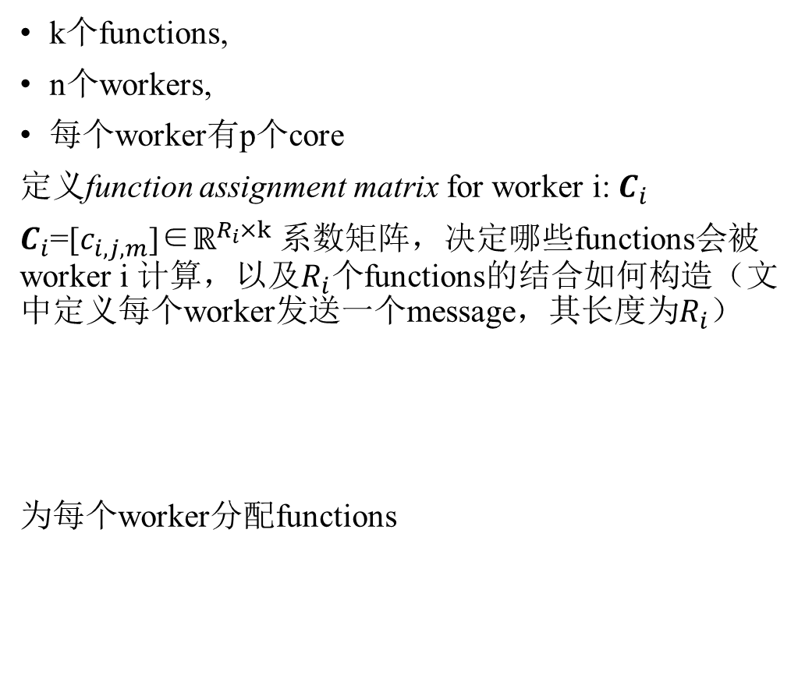
2. DISTRIBUTED MODEL AND PROBLEM FORMULATION
k个functions,
n个workers,
每个worker有p个core
定义function assignment matrix for worker i: $C_{i}$
$C_{i}$=[$c_{i,j,m}$]∈$ℝ^{R_{i}×k}$ 系数矩阵，决定哪些functions会被worker i 计算，以及$R_{i}个$functions的结合如何构造（文中定义每个worker发送一个message，其长度为$R_{i}$）
为每个worker分配functions

Slide 6
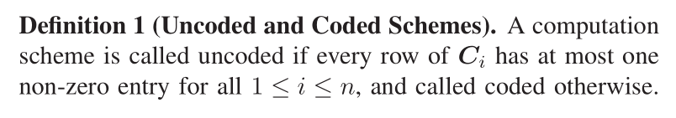
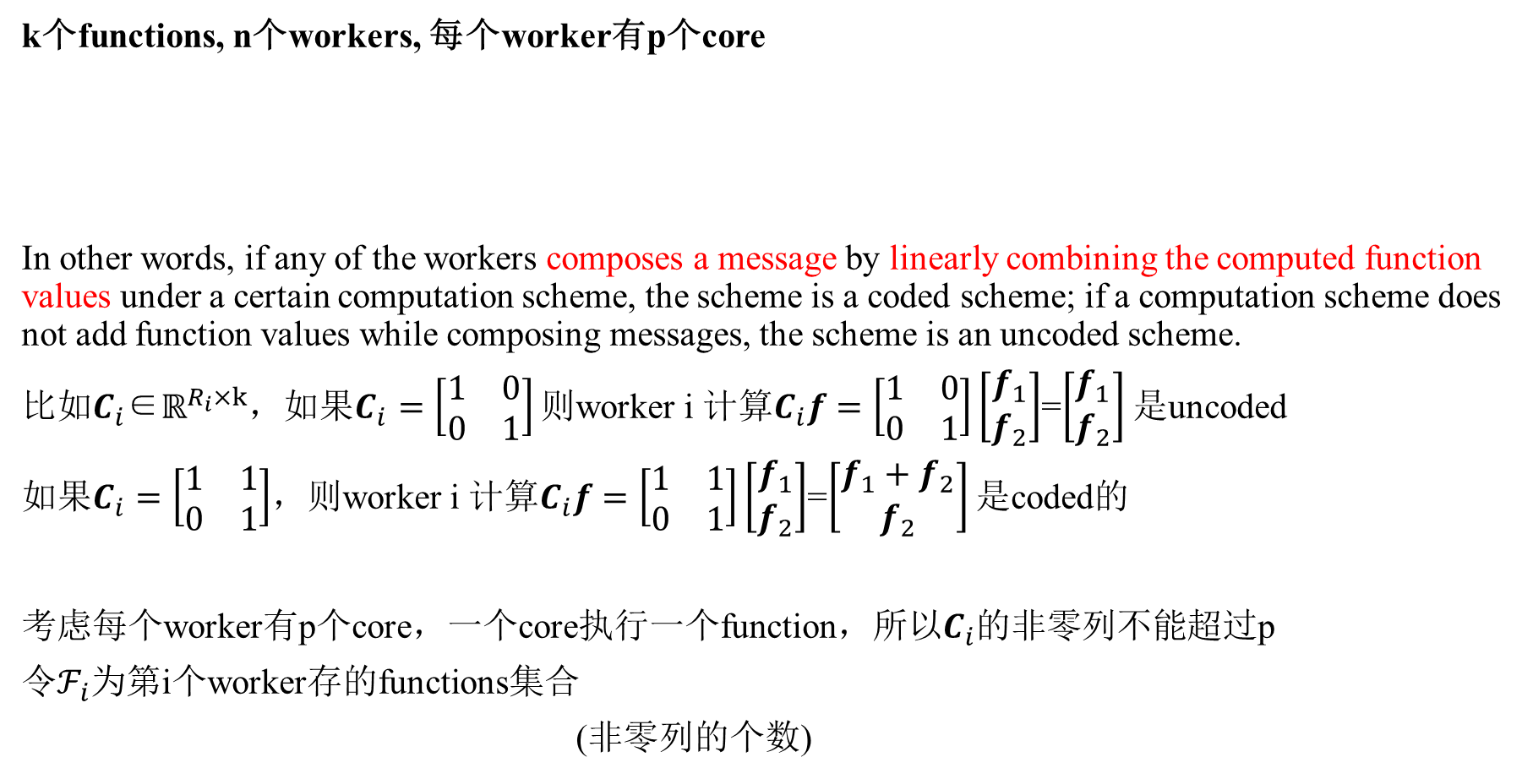
2. DISTRIBUTED MODEL AND PROBLEM FORMULATION
k个functions, n个workers, 每个worker有p个core
In other words, if any of the workers composes a message by linearly combining the computed function values under a certain computation scheme, the scheme is a coded scheme; if a computation scheme does not add function values while composing messages, the scheme is an uncoded scheme.
比如$C_{i}$∈$ℝ^{R_{i}×k}$，如果$C_{i}=\left[\begin{matrix}1 & 0 \\ 0 & 1\end{matrix}\right]$ 则worker i 计算$C_{i}f=\left[\begin{matrix}1 & 0 \\ 0 & 1\end{matrix}\right]\left[\begin{matrix}f_{1} \\ f_{2}\end{matrix}\right]$=$\left[\begin{matrix}f_{1} \\ f_{2}\end{matrix}\right]$ 是uncoded
如果$C_{i}=\left[\begin{matrix}1 & 1 \\ 0 & 1\end{matrix}\right]$，则worker i 计算$C_{i}f=\left[\begin{matrix}1 & 1 \\ 0 & 1\end{matrix}\right]\left[\begin{matrix}f_{1} \\ f_{2}\end{matrix}\right]$=$\left[\begin{matrix}f_{1}+f_{2} \\ f_{2}\end{matrix}\right]$ 是coded的
考虑每个worker有p个core，一个core执行一个function，所以$C_{i}$的非零列不能超过p
令$ℱ_{i}$为第i个worker存的functions集合
(非零列的个数)

Slide 7
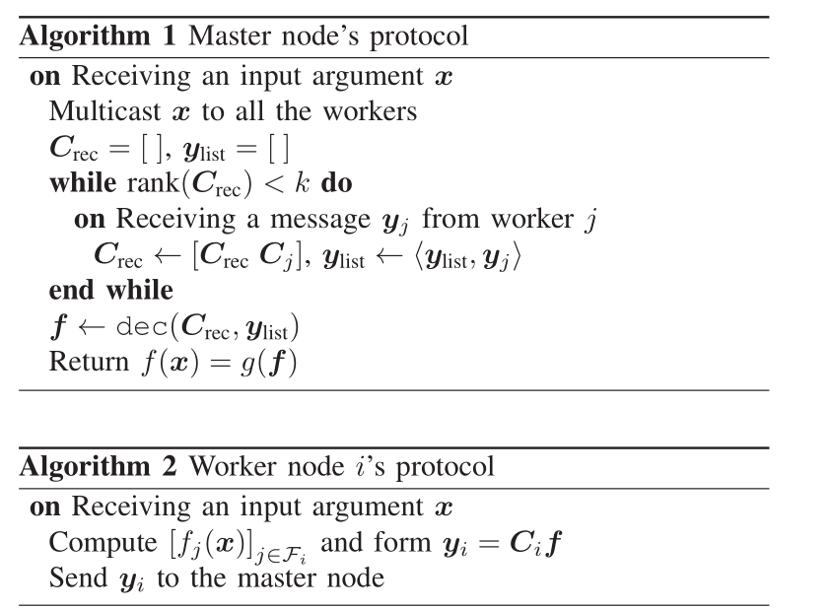
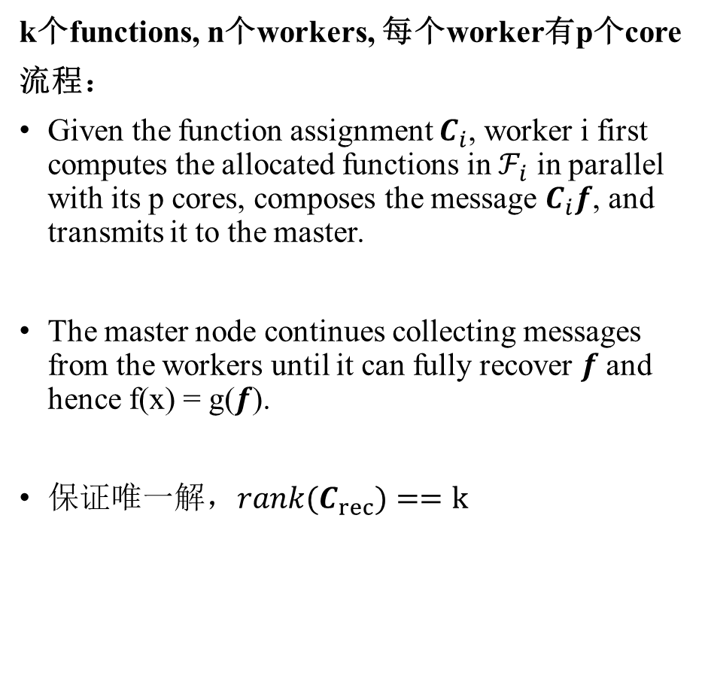
2. DISTRIBUTED MODEL AND PROBLEM FORMULATION
k个functions, n个workers, 每个worker有p个core
流程：
Given the function assignment $C_{i}$, worker i first computes the allocated functions in $ℱ_{i}$ in parallel with its p cores, composes the message $C_{i}f$, and transmits it to the master.
The master node continues collecting messages from the workers until it can fully recover $f$ and hence f(x) = g($f$).
保证唯一解，$rank(C_{rec})==k$

Slide 8

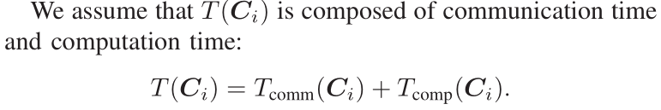

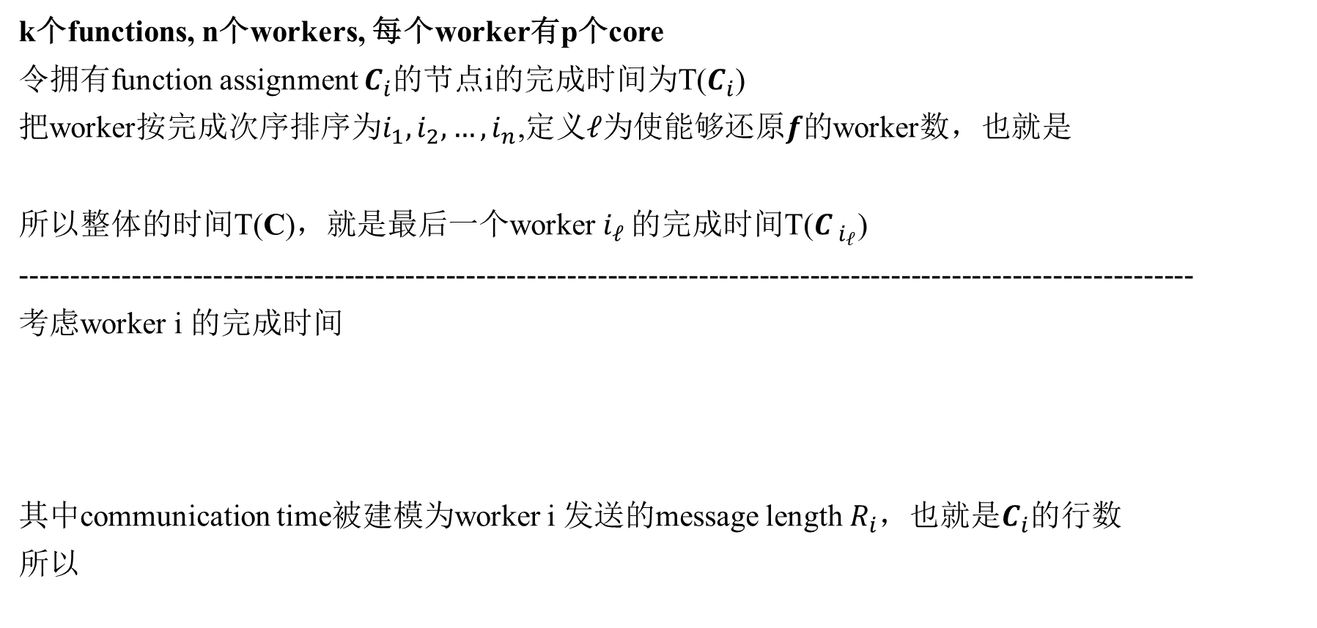
2. DISTRIBUTED MODEL AND PROBLEM FORMULATION (Communication and Computation Time)
k个functions, n个workers, 每个worker有p个core
令拥有function assignment $C_{i}$的节点i的完成时间为T($C_{i}$)
把worker按完成次序排序为$i_{1},i_{2},…,i_{n}$,定义$ℓ$为使能够还原$f$的worker数，也就是
所以整体的时间T(C)，就是最后一个worker${ i}_{ℓ}$ 的完成时间T($C_{{ i}_{ℓ}}$)
--------------------------------------------------------------------------------------------------------------------
考虑worker i 的完成时间
其中communication time被建模为worker i 发送的message length $R_{i}$，也就是$C_{i}$的行数
所以

Slide 9


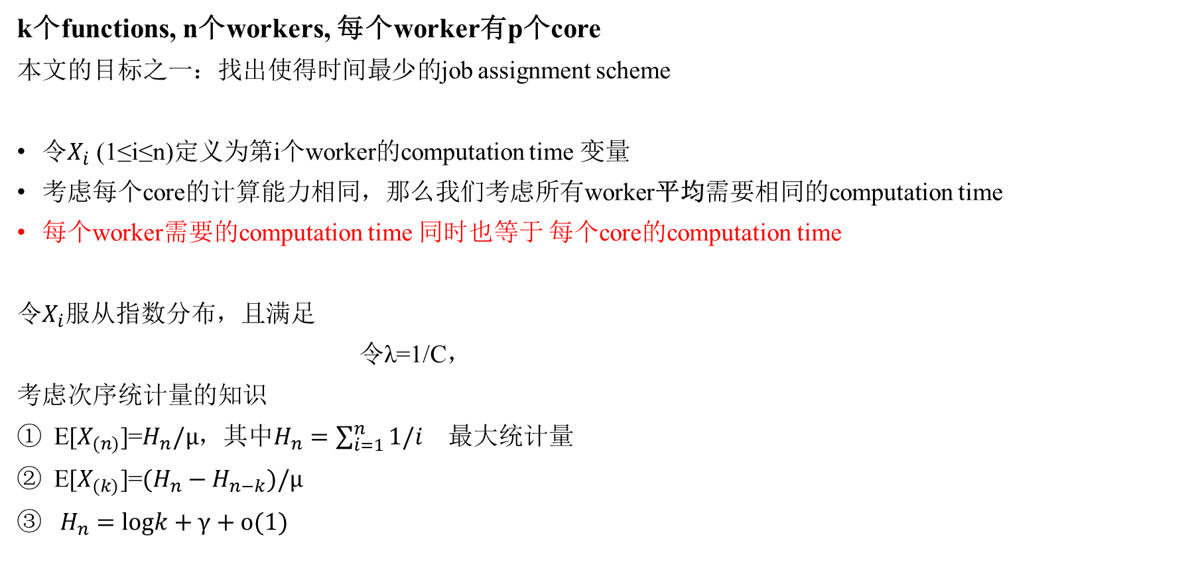
2. DISTRIBUTED MODEL AND PROBLEM FORMULATION (Communication and Computation Time)
k个functions, n个workers, 每个worker有p个core
本文的目标之一：找出使得时间最少的job assignment scheme
令$X_{i}$ (1≤i≤n)定义为第i个worker的computation time 变量
考虑每个core的计算能力相同，那么我们考虑所有worker平均需要相同的computation time
每个worker需要的computation time 同时也等于 每个core的computation time
令$X_{i}$服从指数分布，且满足
令λ=1/C，
考虑次序统计量的知识
E[$X_{(n)}$]=$H_{n}/μ$，其中$H_{n}=\sum_{i=1}^{n}{1/i}$ 最大统计量
E[$X_{(k)}$]=$(H_{n}−H_{n−k})/μ$
$H_{n}=logk+γ+o(1)$

Slide 10
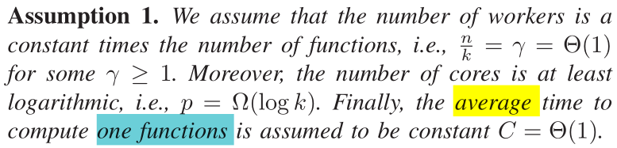
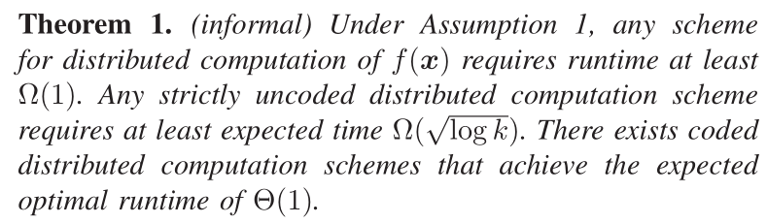
2. DISTRIBUTED MODEL AND PROBLEM FORMULATION (Communication and Computation Time)
k个functions, n个workers, 每个worker有p个core

Slide 11




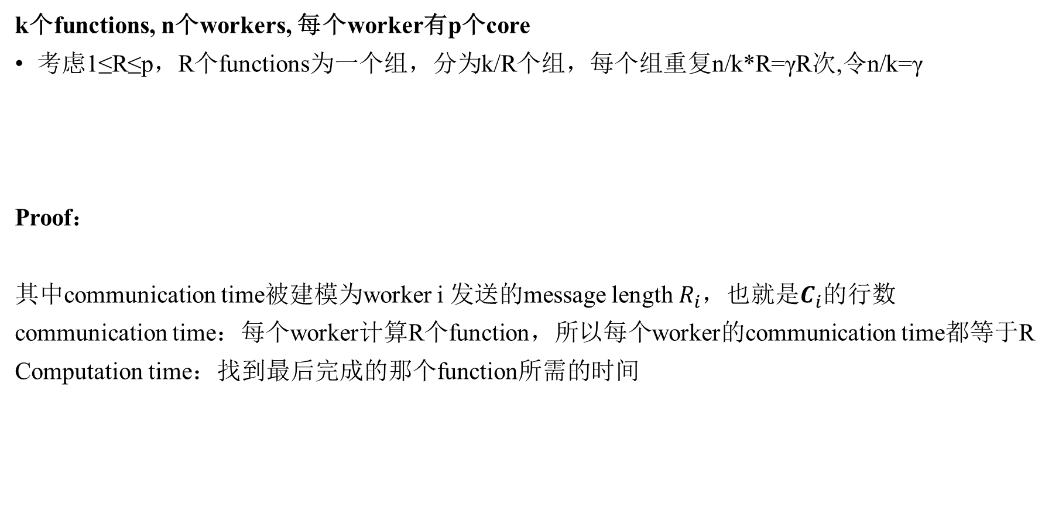
3. UNCODED SCHEMES(replication scheme)
k个functions, n个workers, 每个worker有p个core
考虑1≤R≤p，R个functions为一个组，分为k/R个组，每个组重复n/k*R=γR次,令n/k=γ
Proof：
其中communication time被建模为worker i 发送的message length $R_{i}$，也就是$C_{i}$的行数
communication time：每个worker计算R个function，所以每个worker的communication time都等于R
Computation time：找到最后完成的那个function所需的时间

Slide 12

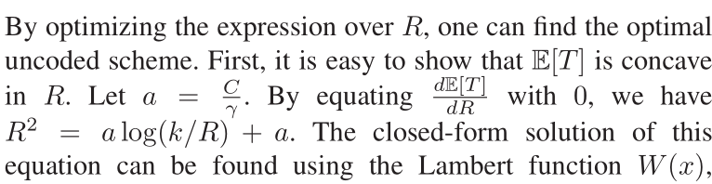
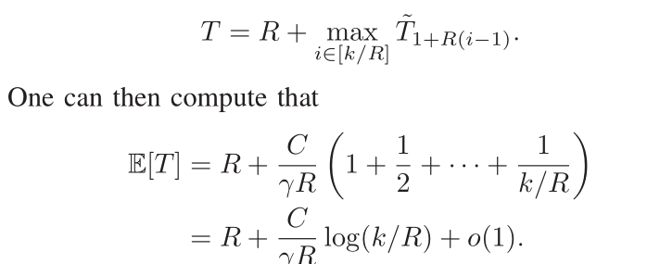
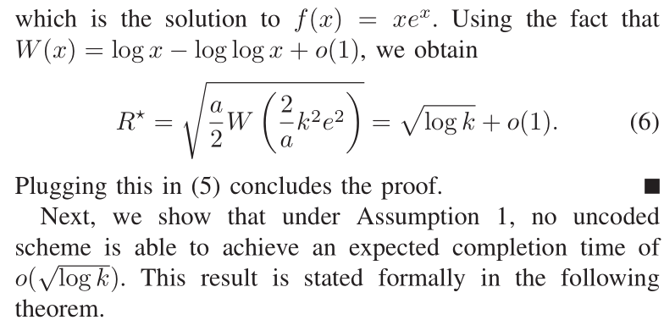
3. UNCODED SCHEMES(replication scheme)
k个functions, n个workers, 每个worker有p个core
每个组内的function的完成时间是一样的，因为core的计算能力相同，不存在straggler
不同组的情况只用考虑相同组内的第一个function时间
由于每个function被分到γR个worker上。有k/R个组。时间可以分解成
γR个变量的最小统计量
k/R个变量的最大统计量

Slide 13



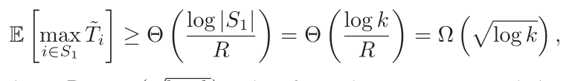

3. UNCODED SCHEMES
k个functions, n个workers, 每个worker有p个core
proof：反证法
假设时间期望为$o(\sqrt{logk})$,那么communication time也是$o(\sqrt{logk})$，即分配到每个worker的functions也是$o(\sqrt{logk})$
所以令R= $o\sqrt{logk}$表示一个worker被分配的最大functions个数。那么n个worker一共要算$o(Rn)$个functions
那么平均的repetition factor是Rn/k= $o\left(\sqrt{logk}\right)$
则1-o(1)部分的functions被重复了$o(\sqrt{logk)}$次，记这些functions为集合S，o(1)部分的functions被重复了$Ω(\sqrt{logk})$
算时间下界，假设o(1)部分的functions没有延迟(不算这部分)，只考虑1-o(1)部分的functions(重复$o(\sqrt{logk)}$次)
令γ= $o\left(\sqrt{logk}\right)$表示S中的function被分到workers的最大个数
注意到随机变量T不独立(有可能function i 被放在相同的节点里)，做了变形
一个新的集合$S_{1}，\left|S_{1}\right|$=$\left|S\right|/$γR=$Θ(k/R^2)个function$s存在于不同的节点

Slide 14
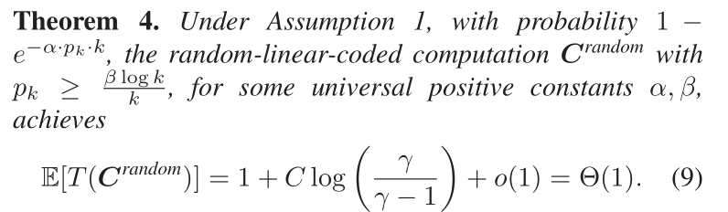
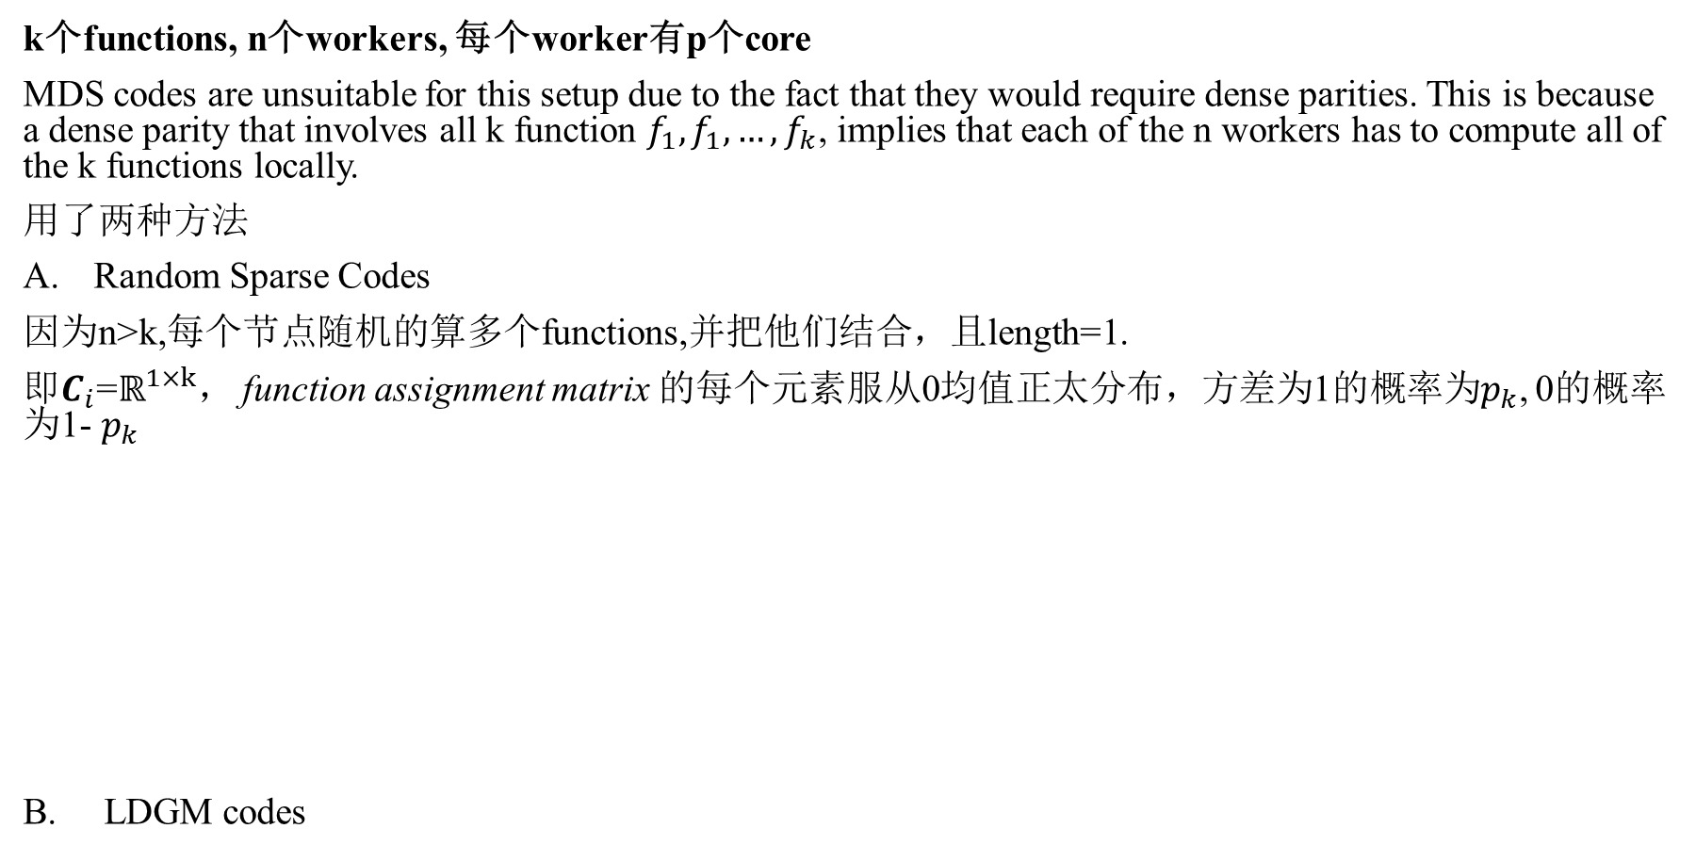
4. CODED SCHEMES
k个functions, n个workers, 每个worker有p个core
MDS codes are unsuitable for this setup due to the fact that they would require dense parities. This is because a dense parity that involves all k function $f_{1},f_{1},…,f_{k}$, implies that each of the n workers has to compute all of the k functions locally.
用了两种方法
Random Sparse Codes
因为n>k,每个节点随机的算多个functions,并把他们结合，且length=1.
即$C_{i}$=$ℝ^{1×k}$， function assignment matrix 的每个元素服从0均值正太分布，方差为1的概率为$p_{k}$, 0的概率为1- $p_{k}$
B. LDGM codes

Slide 15
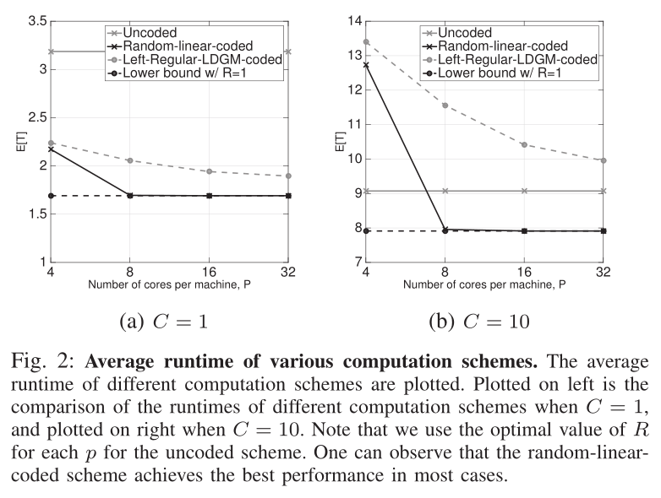
5. SIMULATION RESULTS
n=256, k=128, p∈{4,8,16,32}, R∈{1,2,4,8,16,32}
R的选择使得E[T]最小
C是一个function完成的时间期望

Slide 16
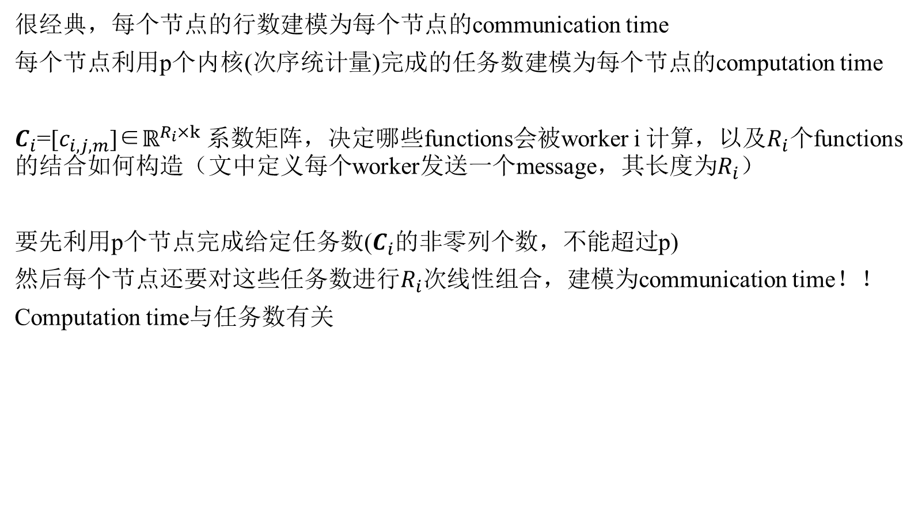
很经典，每个节点的行数建模为每个节点的communication time
每个节点利用p个内核(次序统计量)完成的任务数建模为每个节点的computation time
$C_{i}$=[$c_{i,j,m}$]∈$ℝ^{R_{i}×k}$ 系数矩阵，决定哪些functions会被worker i 计算，以及$R_{i}个$functions的结合如何构造（文中定义每个worker发送一个message，其长度为$R_{i}$）
要先利用p个节点完成给定任务数($C_{i}$的非零列个数，不能超过p)
然后每个节点还要对这些任务数进行$R_{i}$次线性组合，建模为communication time！！
Computation time与任务数有关

